Slide 1

Final Project
HW based FIR filter with kaiser window (400kHz BW, 600kHz Sampling, 200kHz Symbol)
Department of Electronic Engineering
20203033 주 동 준 20203023 우 상 욱

Slide 2
Contents
Introduction
Structure
Verification
Conclusion

Slide 3
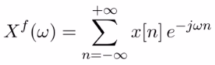
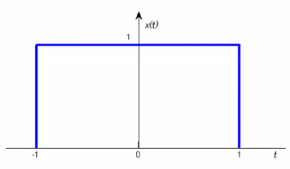
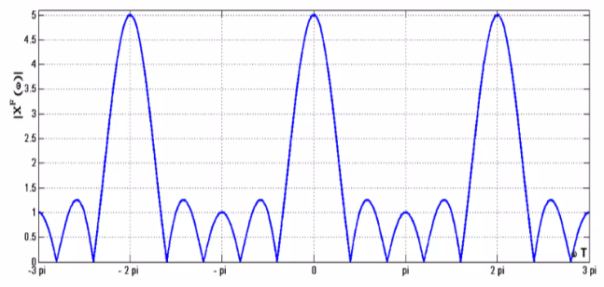
Introduction
Discrete-Time Fourier Transform (D.T.F.T.)
Time domain
Frequency domain

Slide 4
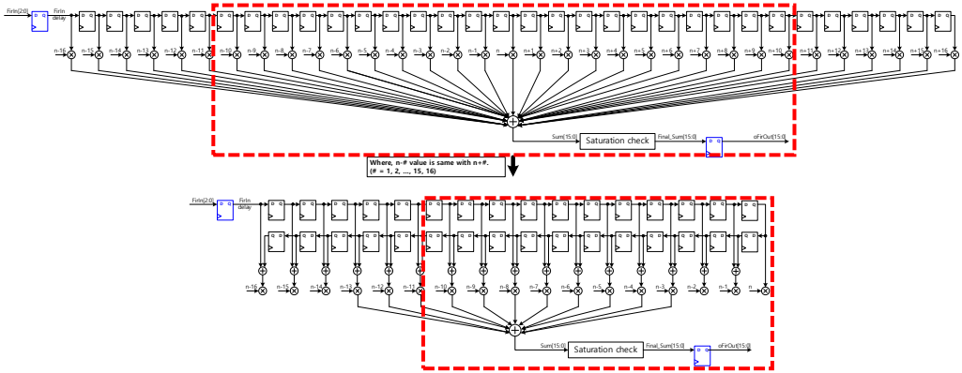
Introduction
Symmetrical structure => Fold filter coefficient

Slide 5
Structure (Block diagram)
iClk12M : Reference Clock
iEnSample600k : Shift FirIn in Delay Chain
iNumOfCoeff : Number of Coefficient ( Variable )
iCoeffUpdate : Update SP-SRAM ( Critical signal )
iCsnRam : Select SP-SRAM
iWrnRam : R/W SP-SRAM
( Low => Write High => Read )
wEnMul : Start Multiplication
wEnAdd : Start Addition
wEnAcc : Start Accumulation
wEnDelay : Operate modules
( DelayChain, Multiplier, Accumulator, Sum )
rCnt_0 : Check Order of Coeff Written at SRAM (40EA)
Check Order of Coeff Read at SRAM (10EA)
rCnt_1 : Check Number of iEnSample600k (80EA)

Slide 6
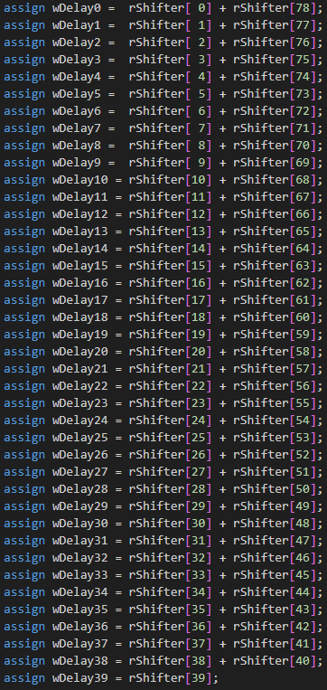
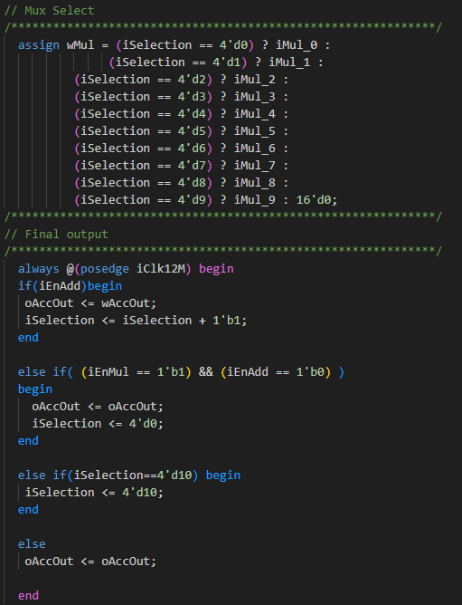
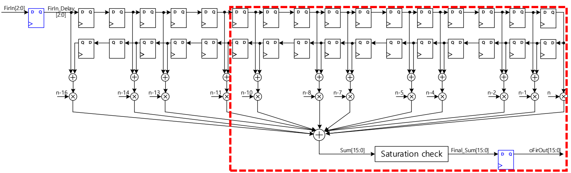
Structure (Block diagram)
Delay Chain
79-Tap Coefficient (Window size : 40EA)

Slide 7
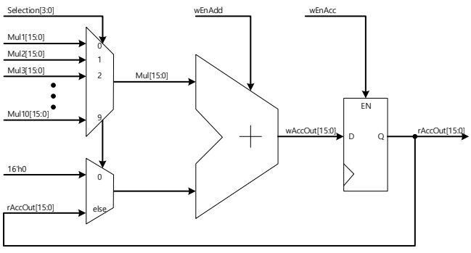
Structure (Block diagram)
Accumulator
Multiplier & Adder (by 10X1 Mux)

Slide 8
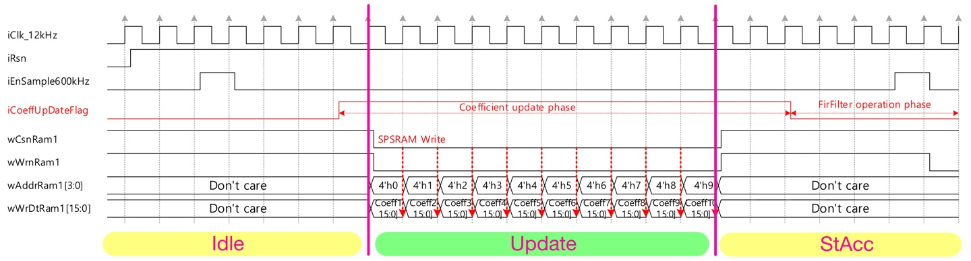
Structure (Timing chart)
1. Coefficient update phase

Slide 9
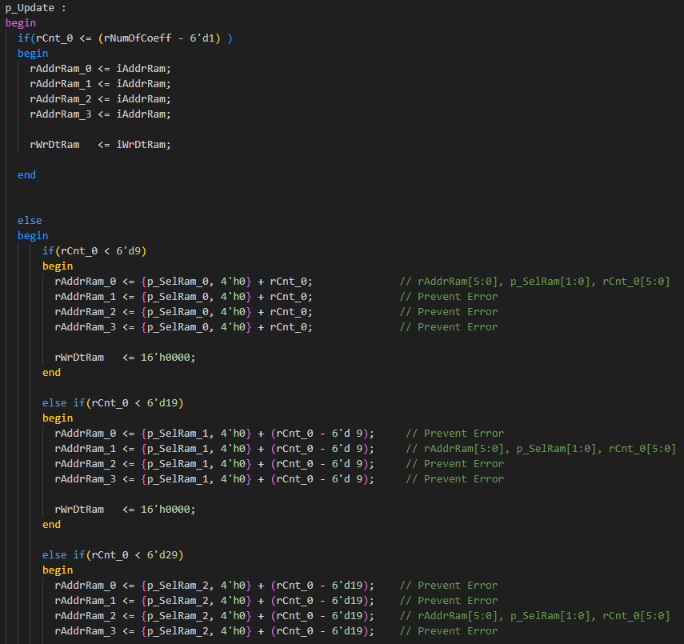
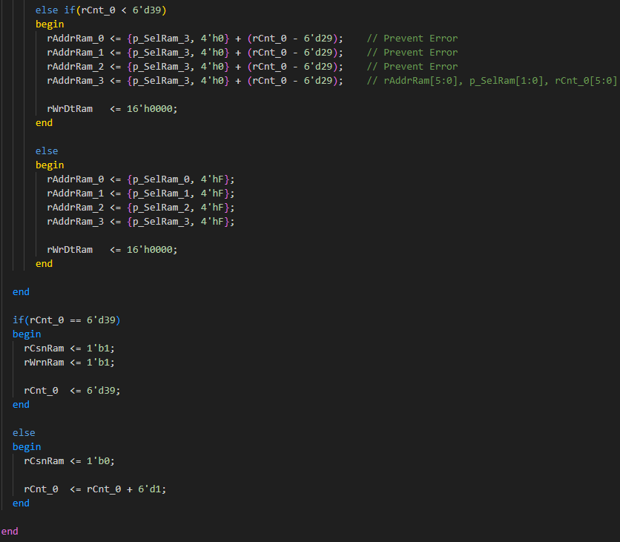
Structure (State Configuration)
1. Coefficient update phase
Under CoeffNum : Correct Address
Over CoeffNum : Ordered Address
(by rCnt_0)
Error : Error Address

Slide 10
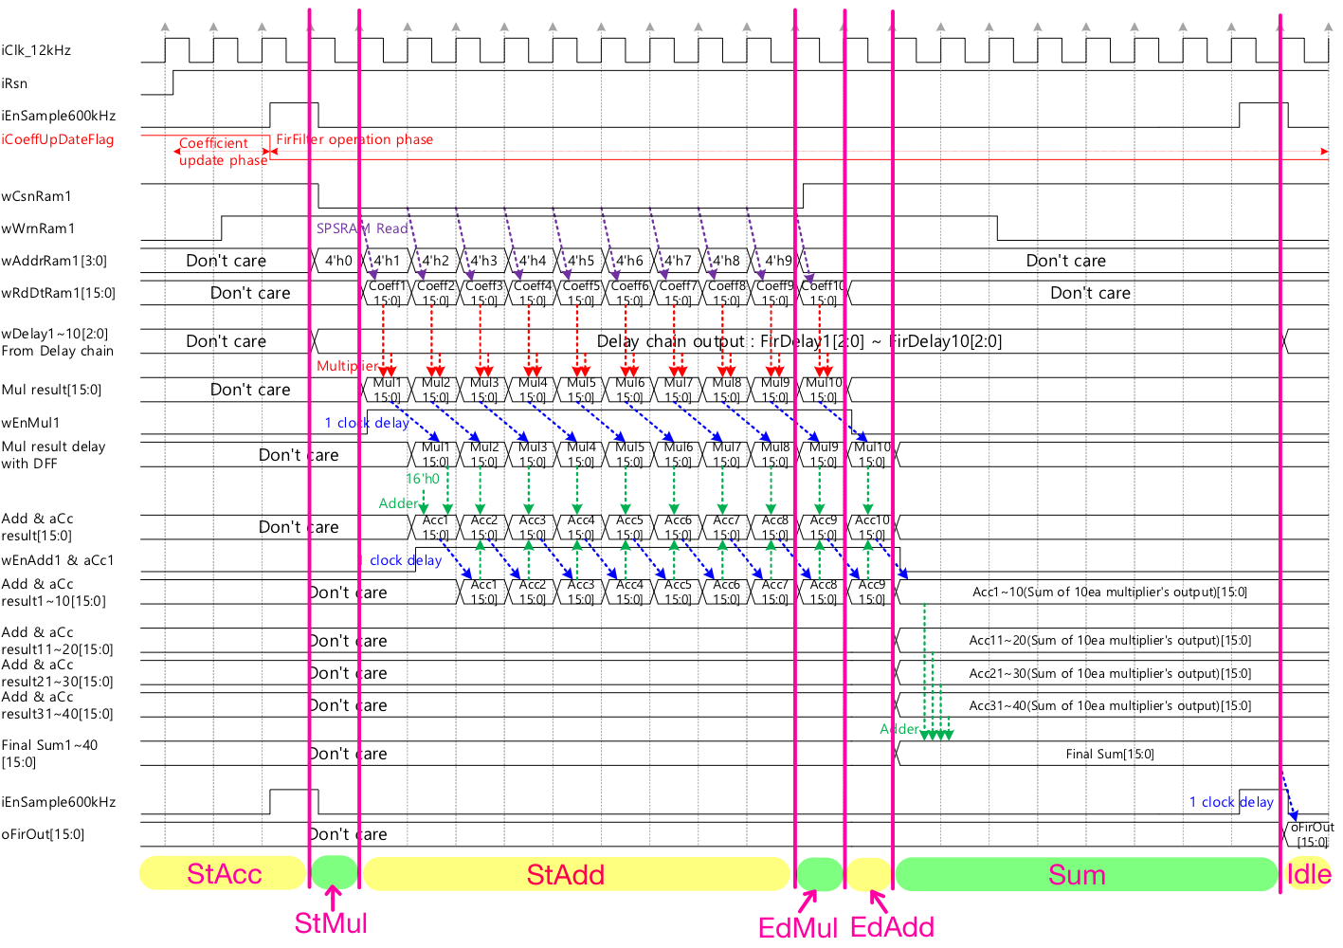
Structure (Timing chart)
2. Filter operation phase

Slide 11
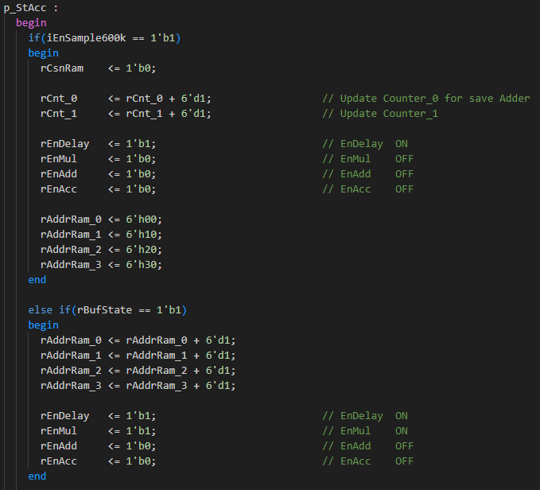
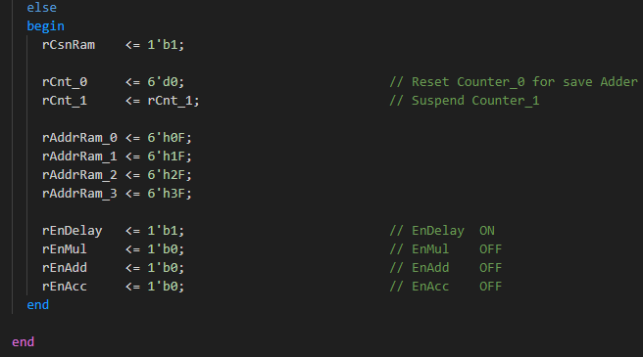
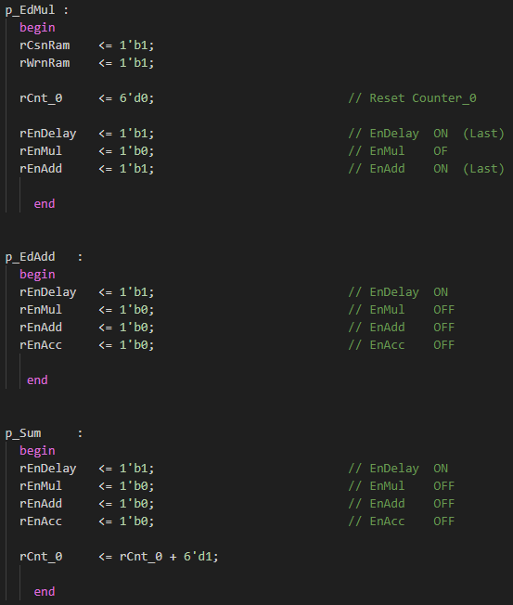
Structure (State Configuration)
2. Filter operation phase
rCnt_0 : Read Coeff from SRAM (10EA)
rCnt_1 : Number of iEnSample600k (80EA)
rEnable : Enable signal for output stability

Slide 12
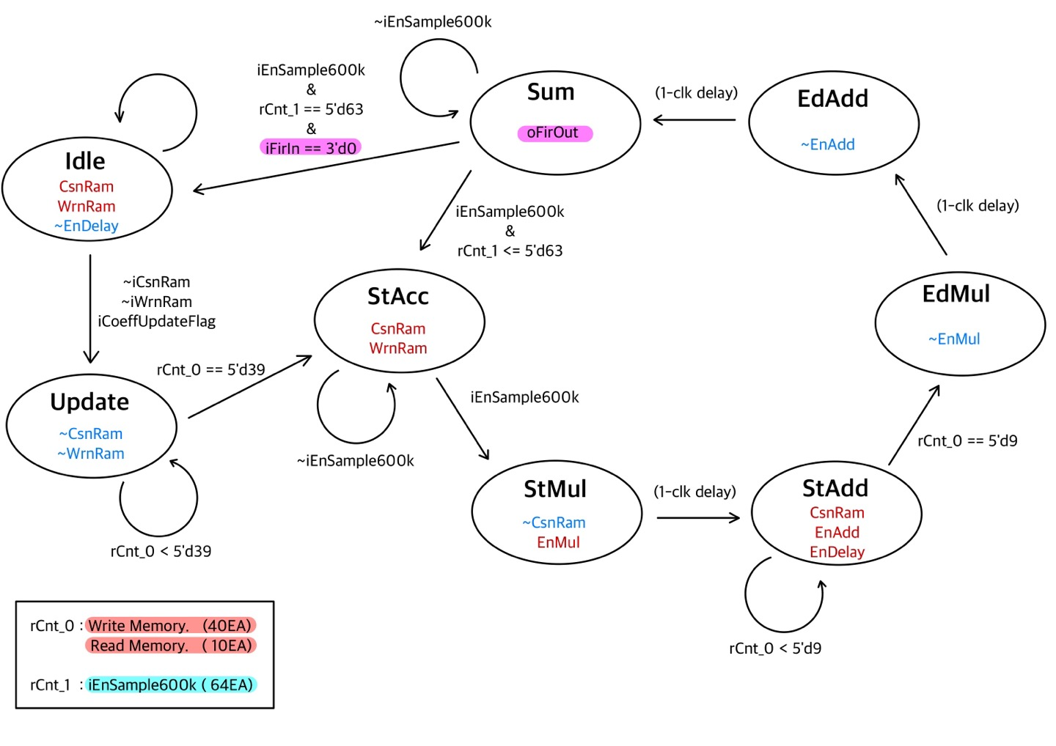
Structure (FSM)
Finite State Machine
[000] Idle : Wait for start (iCoeffUpdateFlag)
[001] Update : Update the coefficients SRAM
[010] StAcc : Wait for start (iEnSample600k)
[011] StMul : Start Multiplication
[100] StAcc : Start Addition & Accumulation
[101] EdMul : End Multiplication
[110] EdAdd : End Addition & Accumulation
[111] Sum : Summation & Next state decision

Slide 13
Verification
Pre-simulation #01
( NumOfCoeff : 17 EA iFirIn : +1 / -1 Coefficient : sinc )
Pre-simulation #02
( NumOfCoeff : 17 EA iFirIn : +3 / -3 Coefficient : sinc )
Tools : Quartus Model-Sim

Slide 14
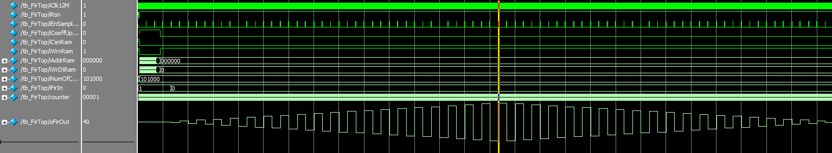
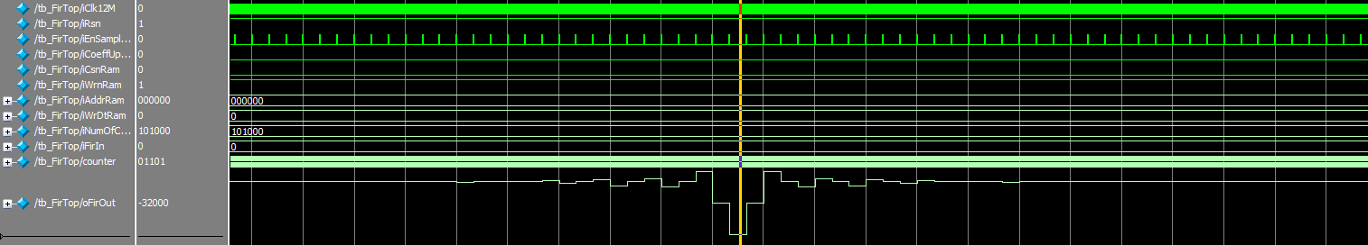
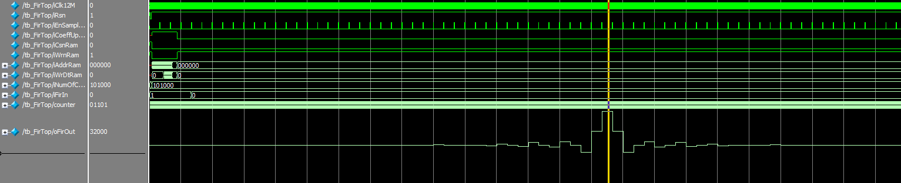
Verification
Pre-simulation #01 ( NumOfCoeff : 17 EA )
ⅰ) iFirIn == 3’b001 ( Coeff : 0-40, Peak coeff : 32000 )
ⅱ) iFirIn == 3’b111 ( Coeff : 0-40, Peak coeff : -32000 )
Tools : Quartus Model-Sim

Slide 15
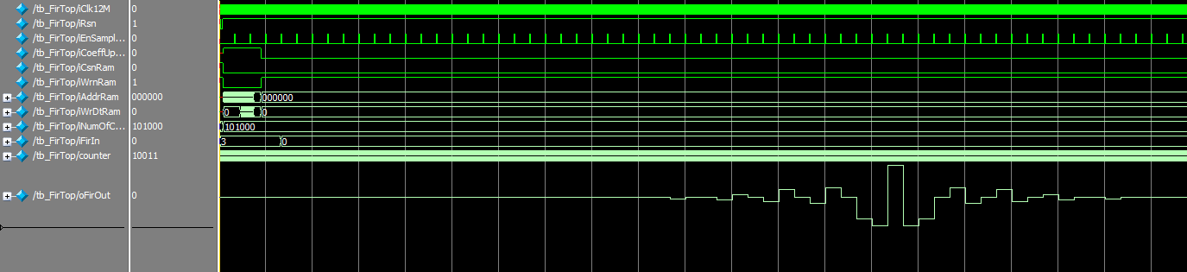
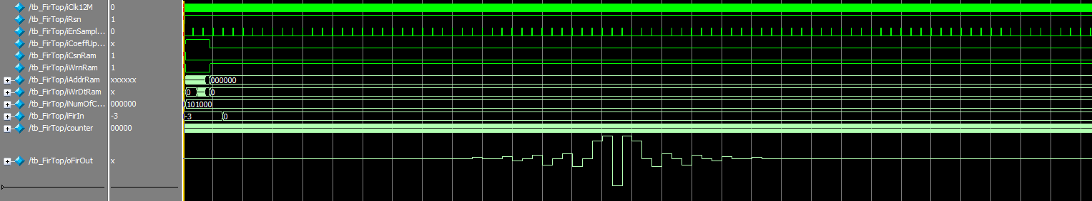
Verification
Pre-simulation #02 ( NumOfCoeff : 17 EA )
ⅰ) iFirIn == 3’b011 ( Coeff : 0-40, Peak coeff : 96000 )
ⅱ) iFirIn == 3’b101 ( Coeff : 0-40, Peak coeff : -96000 )
Tools : Quartus Model-Sim

Slide 16
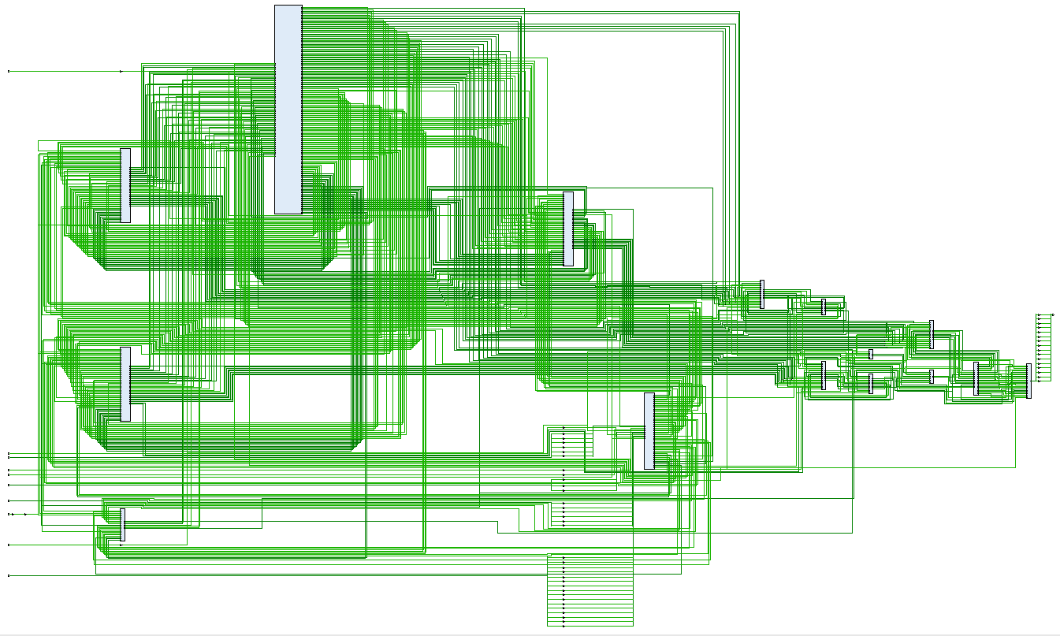
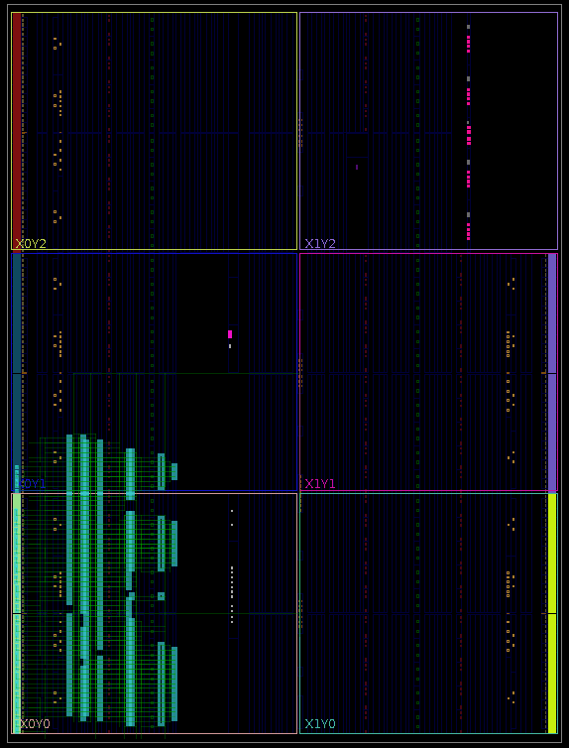
Verification
1) Synthesis 2) Implementation
Tools : Xilinx Vivado Parts : xc7a35tftg256-1

Slide 17
Verification
Input : Data-set
Post-simulation #01
( NumOfCoeff : 32 EA iFirIn : +1 )
Post-simulation #02
( NumOfCoeff : 32 EA iFirIn : +3 )
Tools : Xilinx Vivado Parts : xc7a35tftg256-1

Slide 18
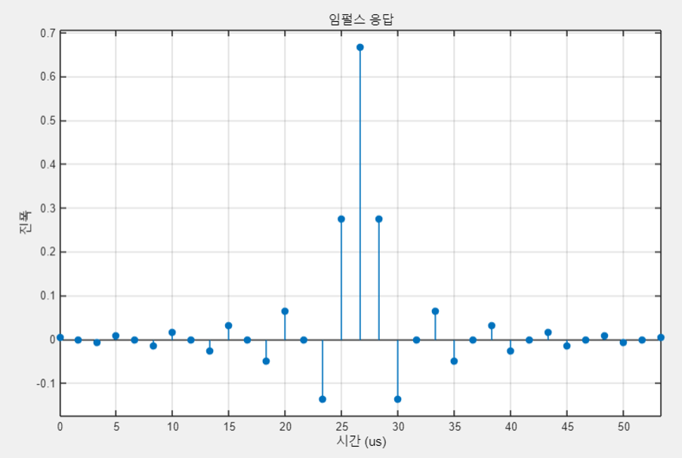
FIR filter with kaiser window
n | Integer | Binary
n-16 | 3 | 00_0000_0011
n-15 | 0 | 00_0000_0000
n-14 | 6 | 11_1111_1010
n-13 | 6 | 00_0000_0110
n-12 | 0 | 00_0000_0000
n-11 | 11 | 11_1111_0101
n-10 | 13 | 00_0000_1101
n-9 | 0 | 00_0000_0000
n-8 | 19 | 11_1110_1101
n-7 | 24 | 00_0010_1000
n-6 | 0 | 00_0000_0000
n-5 | 37 | 11_1110_0101
n-4 | 48 | 00_0011_0000
n-3 | 0 | 00_0000_0000
n-2 | 102 | 11_1001_1010
n-1 | 206 | 00_1100_1110
n | 500 | 01_1111_0100

Slide 19
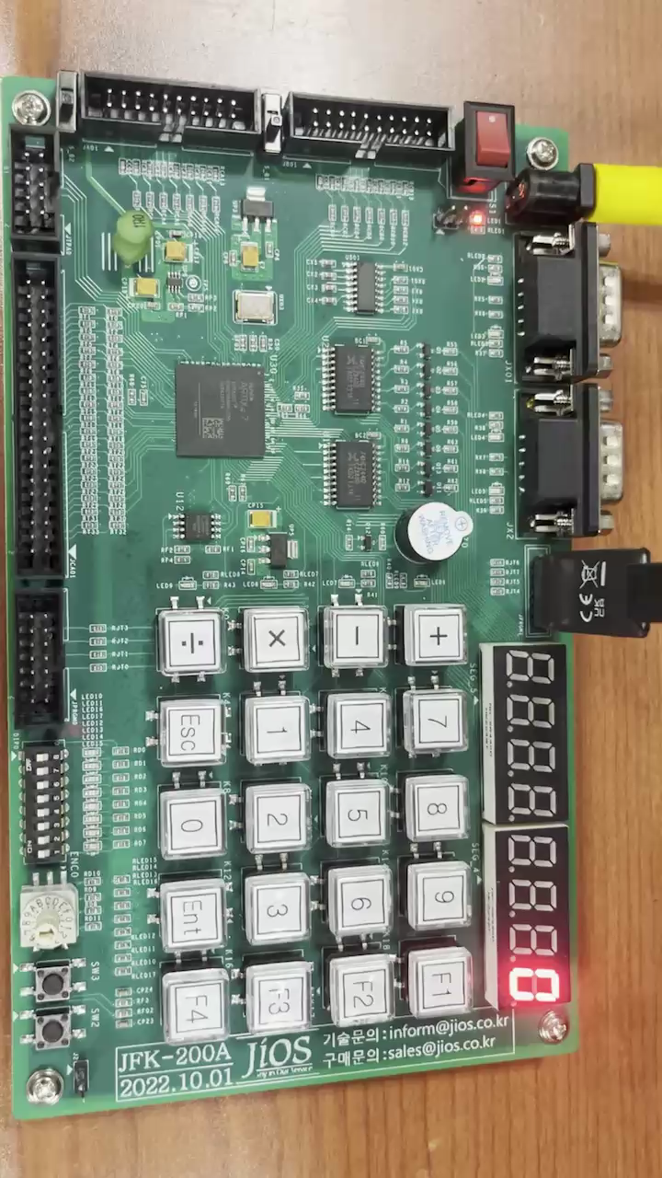
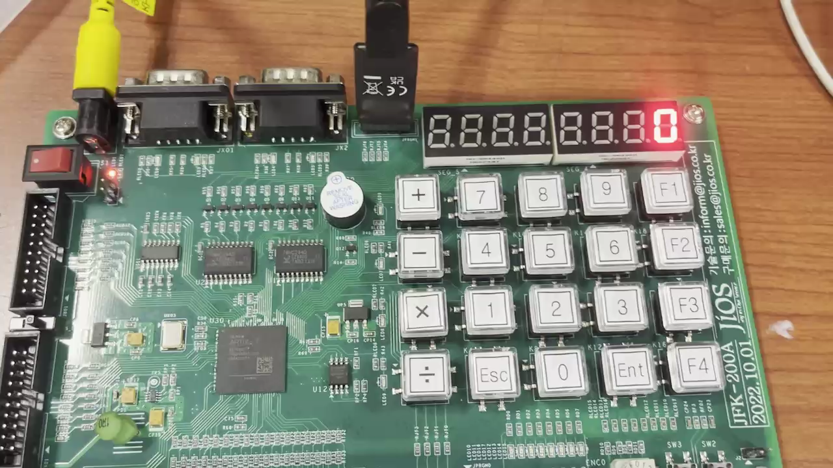
Verification
Post-simulation #01
Post-simulation #02
Tools : Xilinx Vivado Parts : xc7a35tftg256-1

Slide 20
Conclusion
Problem
Randomly specified address : Adderess of SP-SRAM

Slide 21
Conclusion
Improvement
Randomly specified address => APB Protocol Module

Slide 22
Thank you
Department of Electronic Engineering
20203033 주 동 준 20203023 우 상 욱

